Slide 1
Quality Assurance
Through Software Engineering
Systems Analysis and Design

Slide 2
Major Topics
Six Sigma
Quality assurance
Walkthroughs
Structure charts
Modules
Data and control passing
Documentation
Testing
10-<number>

Slide 3
Quality Assurance
Three quality assurance approaches through software engineering have been developed to evaluate the quality of the information system's design and analysis
10-<number>

Slide 4
Guidelines for Quality Software
Quality assurance approaches are:
  Securing total quality assurance through designing systems and software with a top-down and modular approach.
  Documenting software with appropriate tools.
  Testing, maintaining, and auditing software.
10-<number>

Slide 5
Six Sigma
Six Sigma is a culture built on quality.
Six Sigma uses a top-down approach.
Project leader is called a Black Belt.
Project members are called Green Belts.
Master Black Belts have worked on many projects.
There are seven steps in Six Sigma.
10-<number>

Slide 6
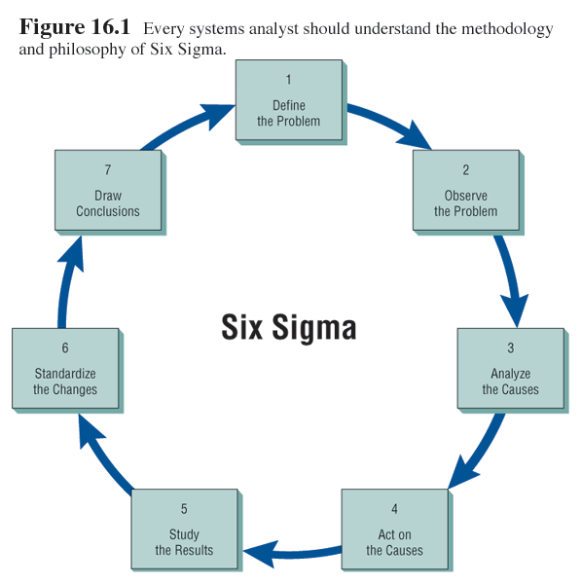
Steps of Six Sigma
10-<number>

Slide 7
General Software Design Principles:
S/w must conform to the requirements specification document created during analysis & any modifications added later on.
S/w must be reliable over time while processing a potentially limitless combination & types of data.
The s/w must be maintainable & evolutionary over time-upgradeable to accommodate changes
10-<number>

Slide 8
The s/w must be easy to use (user friendly)
The s/w must be easy to test & implement using the test plans.
The s/w must use computer resources efficiently - minimize resources e.g. memory, processing power.
The s/w should work correctly – should avoid errors.
10-<number>

Slide 9
Total Quality Management
Total quality management (TQM) is a conception of quality as an evolutionary process toward perfection instead of conceiving quality as controlling the number of defective products produced.
The full organizational support of management and early commitment to quality from the analyst and from the business are necessary.
10-<number>

Slide 10
Structured Walkthroughs
One of the strongest quality assurance actions is structured walkthroughs.
Walkthroughs use peer reviewers to monitor the system's programming and overall development.
They point out problems, and allow the programmer or analyst to make suitable changes.
10-<number>

Slide 11
Personal Involved in Structured Walkthroughs
Structured walkthroughs involve at least four people:
  The person responsible for the part of the system being reviewed.
  A walkthrough coordinator.
  A programmer or analyst peer.
  A person to take notes about suggestions.
10-<number>

Slide 12
Software Construction strategies
Bottom-up Approach: starts with writing code for lowest-level details of the system & proceeding to the higher levels by a progressive aggregation of details until they fit collectively fit the system requirements. It therefore Involves:
  Identifying the processes that need computerization as they arise and analyzing them as systems.
  Either coding them or purchasing COTS (commercial off-the-shelf) software to meet the immediate problem.
10-<number>

Slide 13
Disadvantages of a Bottom-up Approach
The disadvantages of a bottom-up approach to design are:
  There is a duplication of effort in purchasing software, and entering data.
  Much worthless data are entered into the system.
  Overall organizational objectives are not considered and therefore cannot be met.
10-<number>

Slide 14
The Top-Down Approach
Top-down design allows the systems analyst to ascertain overall organizational objectives along with ascertaining how they are best met in an overall system.
The system is divided into subsystems and their requirements (functional decomposition)
10-<number>

Slide 15
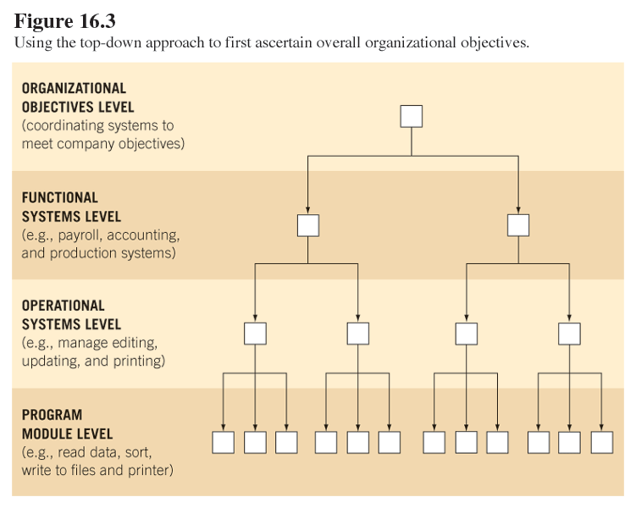
Using the Top-Down Approach
10-<number>

Slide 16
Advantages of the Top-down Approach
The advantages of a top-down approach to design are:
  Avoiding the chaos of attempting to design a system “all at once”.
  The ability to have separate systems analysis teams working in parallel on different but necessary subsystems.
  Losing sight of system goals as a result of getting so mired in detail.
10-<number>

Slide 17
Disadvantages of the Top-down Approach
The three disadvantages of a top-down approach are:
  There is a danger that the system will be divided into the wrong subsystems.
  Once subsystem divisions are made, their interfaces may be neglected or ignored.
  The subsystems must be reintegrated, eventually.
10-<number>

Slide 18
Modular Programming and the Top-Down Approach
The modular programming concept is useful for a top-down approach.
  Once the top-down design approach is taken, the whole system is broken into logical, manageable portions or modules.
  They should be functionally cohesive, accomplishing only one function.
10-<number>

Slide 19
Advantages of Modular Programming
Advantages of modular programming are:
  Modules are easier to write and debug.
    Tracing an error in a module is less complicated.
    A problem in one module should not cause problems in others.
  Modules are easier to maintain.
  Modules are easier to grasp because they are self-contained subsystems.
10-<number>

Slide 20
Guidelines for Modular Programming
Four guidelines for correct modular programming are:
  Keep each module to a manageable size.
  Pay particular attention to the critical interfaces.
  Minimize the number of modules the user needs to modify when making changes.
  Maintain the hierarchical relationships set up in the top-down phases.
10-<number>

Slide 21
Linking Programs in Microsoft Windows
There are two systems to link programs in Microsoft Windows:
  Dynamic Data Exchange (DDE) updates data in one program based on data in another program.
  Object Linking and Embedding (OLE) where an object in a second program retains the properties of an object in the first program.
10-<number>

Slide 22
Structure Charts
The recommended tool for designing a modular, top-down system is a structure chart.
They help systems analysts by providing a picture of modules and the relationships among those modules.
  Consists of rectangular boxes that represents the modules
  Connecting lines or arrows
10-<number>

Slide 23
Data and Control Passing
Data and control passed between structure chart modules is either a:
  Data couple, passing only data, shown as an arrow with an empty circle.
  Control couple, passing switches or flags, shown as an arrow with a filled-in circle.
    Switches, which have only two values.
    Flags, that have more than two values.
10-<number>

Slide 24
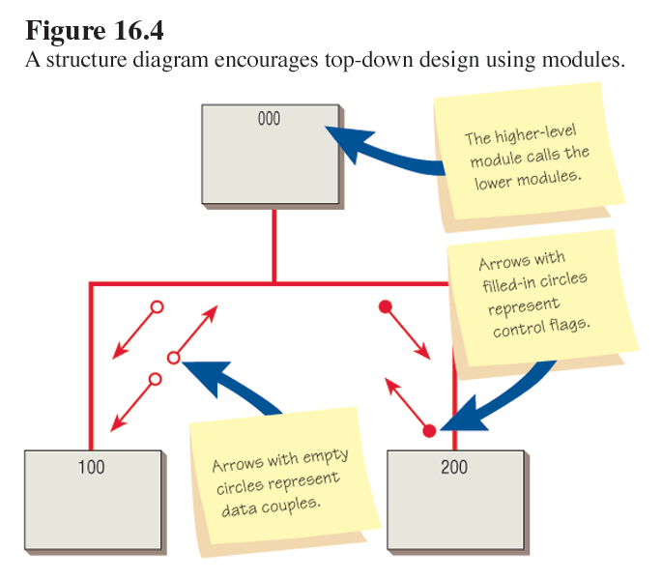
Structure Chart and Coupling
10-<number>

Slide 25
Control Coupling
Control flags should be passed up the structure chart.
  Control modules make the decisions about which lower-level modules should be executed.
  Lower-level modules are functional, performing only one task.
10-<number>

Slide 26
Minimal Coupling
Systems analysts should keep the number of couples to a minimum.
  The fewer data couples and control flags one has in the system, the easier it is to change the system.
10-<number>

Slide 27
Data and Control Passing
Data and control passed between structure chart modules is either:
  Data coupling, only the data required by the module are passed, or
  Stamp coupling, more data than necessary are passed between the modules
  Control coupling
10-<number>

Slide 28
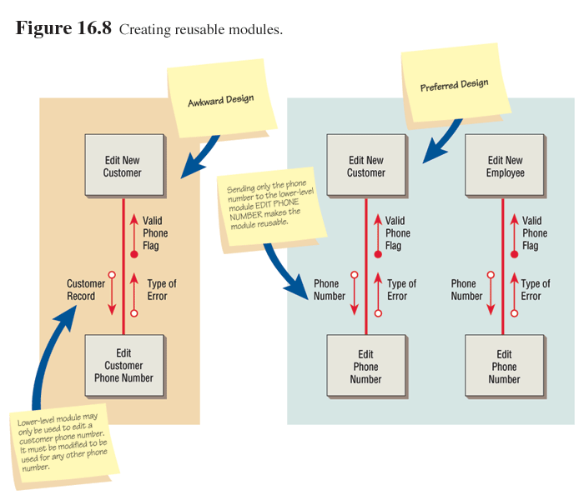
Creating Reusable Modules
10-<number>

Slide 29
Data Flow Diagrams and Structure Charts
A data flow diagram may be used to create a structure chart in the following two ways:
  Indicating the sequence of the modules.
  Indicating modules subordinate to a higher module.
10-<number>

Slide 30
Types of Modules
Modules fall into three classes:
  Control modules, determining the overall program logic.
  Transformational modules, changing input into output.
  Functional modules, performing detailed work.
10-<number>

Slide 31
Improper Subordination
A subordinate module is one found lower on the structure chart, called by another higher module.
Allowing a lower-level module to perform any function of the calling, higher-level module, is called improper subordination.
10-<number>

Slide 32
System Documentation
One of the requirements for total quality assurance is preparation of an effective set of system documentation.
This serves as:
  A guideline for users.
  A communication tool.
  A maintenance reference as well as development reference.
10-<number>

Slide 33
Forms of System Documentation
Documentation can be one of the following:
  Pseudocode.
  Procedure manuals.
  The FOLKLORE method.
10-<number>

Slide 34
Pseudocode
Pseudocode is an English-like code to represent the outline or logic of a program.
It is not a particular type of programming code, but it can be used as an intermediate step for developing program code.
10-<number>

Slide 35
Procedure Manuals
Common English-language documentation
Contain
  Background comments
  Steps required to accomplish different transactions
  Instructions on how to recover from problems
  Online help may be available
  “Read Me” files included with COTS software
10-<number>

Slide 36
Procedure Manuals (Continued)
The biggest complaints with procedure manuals are that:
  They are poorly organized.
  It is difficult to find needed information.
  The specific case in question does not appear in the manual.
  The manual is not written in plain English.
10-<number>

Slide 37
Web Documentation
A Web site can help maintain and document the system by providing:
  FAQ (Frequently Asked Questions).
  Help desks.
  Technical support.
  Fax-back services.
10-<number>

Slide 38
FOLKLORE Documentation
The FOLKLORE documentation method collects information in the categories of:
  Customs.
  Tales.
  Sayings.
  Art forms.
10-<number>

Slide 39
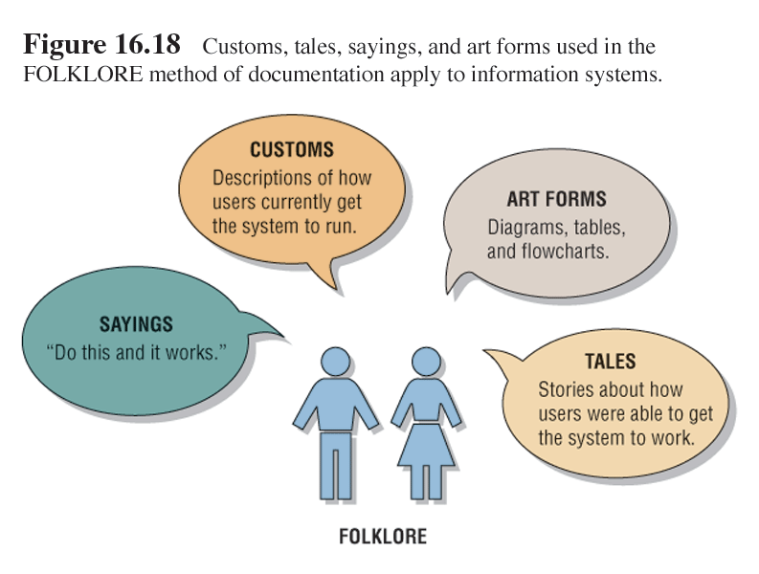
FOLKLORE Documentation
10-<number>

Slide 40
Choosing a Documentation Technique
Guidelines for choosing a documentation technique:
  Is it compatible with existing documentation?
  Is it understood by others in the organization?
  Does it allow you to return to working on the system after you have been away from it for a period of time?
10-<number>

Slide 41
Choosing a Documentation Technique
Guidelines for choosing a documentation technique (continued):
  Is it suitable for the size of the system you are working on?
  Does it allow for a structured design approach if it is considered to be more important than other factors?
  Does it allow for easy modification?
10-<number>

Slide 42
Testing Overview
The new or modified application programs, procedural manuals, new hardware, and all system interfaces must be tested thoroughly.
10-<number>

Slide 43
Software Testing Principles
S/w testing begins with plans for tests & ends with the user accepting the tested s/w: test plans should be developed when the requirements specification document is being developed & can be updated during design as well. Plans for the user acceptance test should conform to the user requirements as documented in the requirements specification document.
10-<number>

Slide 44
Testing Principles:
The testing’s intent is to cause & discover errors: testing should be done with as little pride of ownership as possible.
10-<number>

Slide 45
Testing Principles:
Rules of reasonableness should prevail: testing should follow commonly accepted testing techniques designed to provide a certain threshold of statistical confidence in the tests
10-<number>

Slide 46
Testing Procedures
The following testing process is recommended:
  Program testing with test data.
  Link testing with test data.
  Full system testing with test data.
  Full system testing with live data.
10-<number>

Slide 47
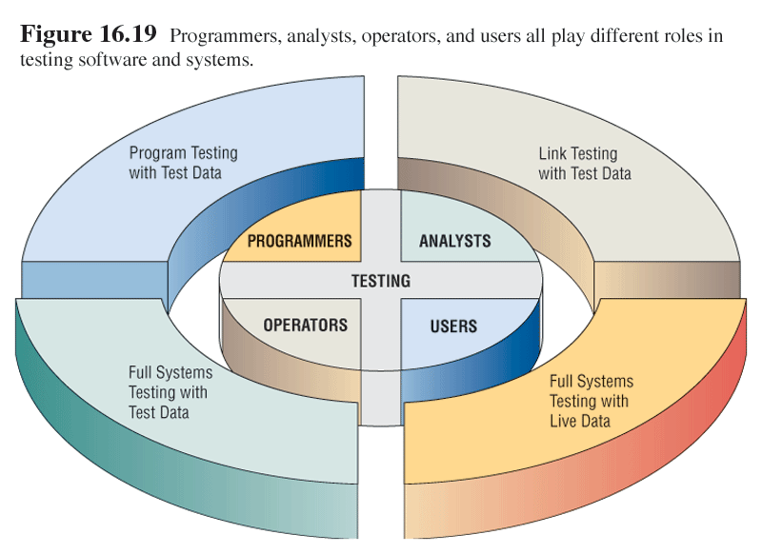
Organizational Roles and Testing
10-<number>

Slide 48
Program Testing with Test Data
Desk check programs.
Test with valid and invalid data.
Check for errors and modify programs.
10-<number>

Slide 49
Link Testing with Test Data
Also called string testing
See if programs can work together within a system
Test for normal transactions
Test with invalid data
10-<number>

Slide 50
Full System Testing with
Test Data
Operators and end users test the system.
Factors to consider:
  Is adequate documentation available?
  Are procedure manuals clear?
  Do work flows actually flow?
  Is output correct and do the users understand the output?
10-<number>

Slide 51
Full System Testing with Live Data
Compare the new system output with the existing system output.
Only a small amount of live data are used.
10-<number>

Slide 52
S/W Testing Strategies
Top-Down testing: follows the functional decomposition approach to problem-solving. It starts at an overview/high-level view of the system to be tested, then works its way down into the details of the system, layer by layer until the bottom most programmed modules.
Bottom-up testing: starts with details of the system & proceeds to higher levels by a progressive aggregation of details until they collectively fit the requirements of the system.
10-<number>

Slide 53
Middle-out testing: starts somewhere in the ‘middle’ of the system that seems convenient & tests both upward to higher levels & downward to lower levels.
Hybrid is a combination of the 3 strategies.
Regardless of which strategy chosen, s/w testers view portions of the system, subsystem, programs & modules as either a white box or black box as they test.
10-<number>

Slide 54
White box: testing portion of the system from an inside perspective i.e. ability to actually look at the code statements of portion being tested & correct errors.
Black box: testing portion of the system from an outside perspective i.e. the tester doesn’t have the ability to look at the code. This is common when testing software written by someone else.
10-<number>

Slide 55
Alpha testing: testing done in-house by programmers, s/w engineers & internal users. i.e. a 1st cut at the acceptance tests is done in-house by in-house staff.
Beta testing: Usually involves a select group of customers to perform tests on the s/w as they would use it in their normal environment. In exchange, the customers get an advance copy of the s/w which usually has new features.
10-<number>

Slide 56
A Generic Software Testing Methodology:
Has the feedback and fall back loop indicating that when errors are discovered at any level of the methodology, programming staff will need to make coding changes followed by a trip back through the layers to ensure defect-free code in all test levels.
Large systems are built of sub-systems which are built on modules that are composed of procedures & functions.
10-<number>

Slide 57
Stages of the Testing process:
Unit/module testing: individual components are tested i.e. individual program modules tested by developers.
Integration testing: is the combining of several units/modules for the purpose of testing them as a whole.
As s/w is being constructed & simultaneously being tested for integration with other s/w modules by the programmer, a technique called Stub testing. It is performed on individual modules as they are being integrated in a top-down, bottom-up, or middle-out manner.
10-<number>

Slide 58
LEVEL 1
Testing
sequence
LEVEL 1
…..
LEVEL 2
LEVEL 2
LEVEL 2
LEVEL 2
LEVEL 2 STUBS
LEVEL 3 STUBS
10-<number>

Slide 59
Stages of testing ..ctd
Function testing- is the combining of one or more integration tested groups of modules that collectively perform a user identified function, as documented in the requirements specification document.
System testing- combines all of the user-defined functions together to form the subsystem or system.
Acceptance testing- is similar to system testing. However the user is the one who usually does the testing. These tests are most often conducted with well-defined test data, as well as the actual, real data.
10-<number>

Slide 60
Methodology Framework & its relationship with other activities & deliverables of IS development
==
Systems Analysis |  | User Specification |  | Acceptance Testing
Systems Design |  | System Specification |  | System Testing
Systems Design |  | Software specification |  | Function Testing
Program Design |  | Program Specification |  | Integration Testing
Module Design |  | Module Specification |  | Unit Testing
10-<number>

Slide 61
Development & Implementation.
System Development & Implementation:
individual system components are built & tested.
Database is Initialized with data.
At the end of this phase:
Users are provided with a working system i.e. programs & database.
System documentation describing the programs completed.
All users are trained & can use the new system.
10-<number>

Slide 62
Auditing
There are internal and external auditors.
Internal auditors study the controls used in the system to make sure that they are adequate.
Internal auditors check security controls.
External auditors are used when the system influences a company’s financial statements.
10-<number>

Slide 63
Successfully Implementing
The Information System

Slide 64
Objectives:
Installation – Conversion strategies; Activation; Institutionalization
Implementation Critical Success Factors
Evaluation & Review
10-<number>

Slide 65
Implementation
Implementation is the process of assuring that the information system is operational.
It is the conversion of data to the new system’s files, final training of end-users, and transition from the old system to the new system.
It marks the end of Development for a moment, but beginning the user’s realisation of the new/ changed IS
10-<number>

Slide 66
Implementation
Well-trained users are involved in its operation.
Implementation is a critical time for users because the users must switch from the old to the new system & the user must take responsibility for the successful utilization of the new system
10-<number>

Slide 67
Implementation
The development team must anticipate, even expect problems during implementation.
It consists of 3 phases:
Installation
Activation
Institutionalization.
10-<number>

Slide 68
Installation Phase:
This involves putting the new IS in place i.e. physically installing all of the 5 components (h/w, s/w, people, procedures, data) of the IS. Training is part of this phase.
A very significant part of this phase is conversion. This is the switching from one system to another i.e.new IS replacing an obsolete manual or automated IS
10-<number>

Slide 69
Conversion Strategies
Five conversion strategies are:
  Direct/cutover conversion.
  Parallel conversion.
  Gradual/Phased conversion.
  Modular prototype conversion.
  Distributed conversion.
10-<number>

Slide 70
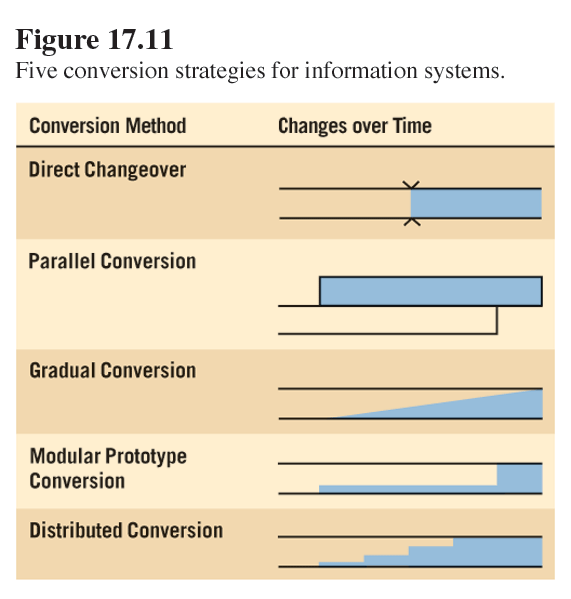
Conversion Strategies
10-<number>

Slide 71
Direct/Cutover conversion:
Is one in which the users use the old system up to a specific point in time after which the users start to use the new system.
Advantages:
No duplication of effort for users.
No transition costs with the old system.
Learning advantage for groups converted later, if cutover is done by groups & cost of running parallel systems is avoided.
10-<number>

Slide 72
Disadvantages:
High risks i.e. it may disrupt operations if new system fails.
Cannot compare results.
Sense of user insecurity i.e. there is no period of adjustment could lead to resistance to change.
10-<number>

Slide 73
Parallel Conversion:
Is one that allows the users to continue using the old system & the new system simultaneously for a period of time, eventually discarding the old system.
Advantages:
Low risk i.e. guarantee of continuity in case the new system fails.
Sense of user security
Ability to compare results with old system
10-<number>

Slide 74
Disadvantages:
Duplication of effort for users.
Transition costs i.e. its expensive employing many people to run both systems.
Additional processing strain on the computers.
10-<number>

Slide 75
Phased Conversion:
Is one in which the new system is implemented in one part of the organisation e.g a single department & eventually extending to other departments.
Advantages:
- In case of failure, the rest of the organisation is not affected.
Based on feedback, changes are made & system is installed to the rest by any of the conversion strategies.
Provides experience & live tests for implementation.
Gives an opportunity to implementers to display the advantages of the new system.
10-<number>

Slide 76
Disadvantages:
May give the impression that the new system is unreliable & not error-free, depending on the effectiveness of the implementers.
10-<number>

Slide 77
Conversion strategy decisions:
Software Engineers base their conversion strategy decisions on the following:
The design of the IS.
User needs and preferences.
Risk factors.
(Give your understanding of what is meant by each of the above)
10-<number>

Slide 78
Activation Phase:
This second phase of implementation deals with getting the users to use the new/changed IS.
Once the IS is installed & conversion performed, the implementation normally moves naturally into the activate phase as the predetermined users begin exercising & using the new system.
10-<number>

Slide 79
During this critical phase, the development team may continue training the users on an ‘as-needed’ basis.
The team should also anticipate & expect problems & be prepared to correct them.
The team should also monitor the users’ usage of the IS, taking note of what the users like & dislike, patterns of usage, shortcut opportunities to improve the IS effectiveness e.t.c
10-<number>

Slide 80
In short, the development team needs to pay serious attention to the IS & its use by the users during this phase & be prepared to maintain, fix & enhance it as the need & opportunity to do so become available.
10-<number>

Slide 81
Training
New system training must be performed.
Analysts must consider:
  Who needs to be trained.
  Who will train them.
  Objectives of training.
  Methods of instruction to be used.
  Sites.
  Materials.
10-<number>

Slide 82
Sources of Training
Possible sources of training for users of information systems include:
  Vendors.
  Systems analysts.
  External paid trainers.
  In-house trainers.
  Other system users.
10-<number>

Slide 83
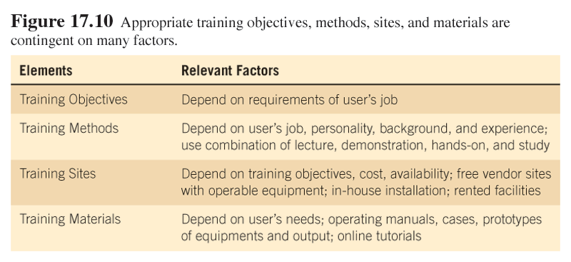
Concerns for Training Objectives, Method, Sites and Materials
10-<number>

Slide 84
Security
Security considerations must be included when implementing a system.
These include:
  Physical security.
  Logical security.
  Behavioral security.
10-<number>

Slide 85
Security (Continued)
Physical security is controlling access to physical computer resources.
Logical security is controlling software access.
Behavioral security is building procedures to prevent persons from misusing computer hardware and software.
10-<number>

Slide 86
Web Security
Precautions used to protect the computer network from both internal and external Web security threats include:
  Virus protection software.
  Email filtering products.
  URL filtering products.
  Firewalls, gateways, and virtual private networks.
10-<number>

Slide 87
Web Security
Precautions used to protect the computer network from both internal and external Web security threats include (continued):
  Intrusion detection products.
  Vulnerability management products.
  Security technologies such as secure socket layering (SSL) for authentication.
  Encryption technologies.
  Public key infrastructure (PKI) use and obtaining a digital certificate.
10-<number>

Slide 88
Ecommerce Privacy Guidelines
Privacy is essential to ecommerce.
Some privacy policy guidelines are:
  Start with a corporate policy on privacy.
  Only ask for information required to complete the transaction.
  Make it optional for customers to fill out personal information on the Web site.
10-<number>

Slide 89
Ecommerce Privacy Guidelines
Some privacy policy guidelines are (continued):
  Use sources that allow you to obtain anonymous information about classes of customers.
  Be ethical in data gathering.
10-<number>

Slide 90
Other Conversion Considerations
Ordering equipment
Ordering external supplies, such as toner cartridges, paper, preprinted forms and so on
Appointing a manager to supervise the preparation of the installation site
Planning, scheduling, and supervising IT personnel who convert files and databases
10-<number>

Slide 91
Maintenance & Review:
This involves tracking changes in h/w, s/w, documentation or procedures to a production system to correct errors, meet new requirements or improving processing efficiency.
10-<number>

Slide 92
Importance of Maintenance:
Necessary to eliminate errors in the system during its working life (corrective maintenance)
Enhancing & modifying the systems to respond to changing user environment & organisational needs, improving system efficiency & enhancing documentation (perfective maintenance)
10-<number>

Slide 93
Changing the application to adapt it to a new h/w, s/w environment (adaptive maintenance).
Ensure feedback procedures are in lace to communicate suggestions.
Therefore, IS planners must always plan for resource availability to carry out these maintenance functions
10-<number>

Slide 94
Evaluation:
This involves determining whether the IS operates as expected & if the costs & benefits are as anticipated.
System managers need to identify the strengths and weaknesses of the new IS
10-<number>

Slide 95
Evaluation Approaches
Several evaluation approaches can be used:
  Cost-benefit analysis.
  Revised decision evaluation approach.
  User involvement evaluations.
  The information system utility approach.
10-<number>

Slide 96
Organizational Metaphors
Organizational metaphors may be used to assist in a successful implementation of a new system.
10-<number>

Slide 97
Organizational Metaphors (Continued)
Zoo
Jungle
War
Journey
Machine
Society
Family
Organism
Game
10-<number>

Slide 98
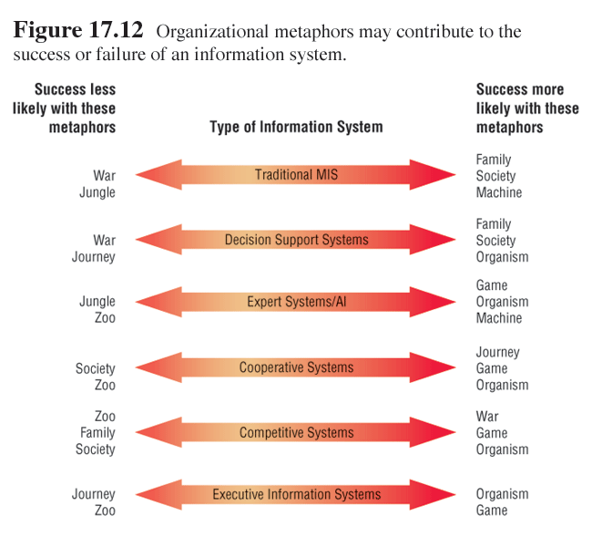
Organizational Metaphors and Types of Information Systems
10-<number>

Slide 99
Interpreting Organizational Metaphors
Zoo indicates success is likely with traditional MIS systems and decision support systems.
Jungle indicates success is likely with decision support systems, cooperative systems, competitive systems, and executive information systems.
10-<number>

Slide 100
Interpreting Organizational Metaphors (Continued)
War indicates success is likely with competitive systems.
Journey indicates success is likely with cooperative systems.
Machine indicates success is likely with traditional MIS systems and expert systems/artificial intelligence.
10-<number>

Slide 101
Interpreting Organizational Metaphors (Continued)
Society indicates success is likely with traditional MIS systems and decision support systems.
Family indicates success is likely with traditional MIS systems and decision support systems.
10-<number>

Slide 102
Interpreting Organizational Metaphors (Continued)
Organism indicates success is likely with decision support systems, expert systems/artificial intelligence, cooperative systems, competitive systems, and executive information systems.
10-<number>

Slide 103
Interpreting Organizational Metaphors (Continued)
Game indicates success is likely with expert systems/artificial intelligence, cooperative systems, competitive systems, and executive information systems.
10-<number>

Slide 104
Information System Utility Evaluation
The information system utility framework is a way to evaluate a new system based on utilities of:
  Possession.
  Form.
  Place.
  Time.
  Actualization.
  Goal.
10-<number>

Slide 105
Information System Utility Evaluation (Continued)
Possession utility answers the question of who should receive output.
Goal utility answers the why of information systems by asking whether the output has value in helping the organization achieve its objectives.
Place utility answers the question of where information is distributed.
10-<number>

Slide 106
Information System Utility Evaluation (Continued)
Form utility answers the question of what kind of output is distributed to the decision maker.
Time utility answers the question of when information is delivered.
Actualization utility involves how the information is introduced and used by the decision maker.
10-<number>

Slide 107
Web Site Evaluation
Corporate Web sites should be evaluated.
The following is a list of key things to learn about the Web site visitors:
  Know how often the Web site is visited.
  Learn details about specific pages on the site.
  Find out demographic and other information about Web site visitors.
10-<number>

Slide 108
Web Site Evaluation
The following is a list of key things to learn about the Web site visitors (continued):
  Discover if visitors can properly fill out the Web forms.
  Find out who is referring Web site visitors to the client’s Web site.
  Determine what browsers visitors are using.
  Find out if the client’s Web site visitors are interested in advertising the Web site.
10-<number>

Slide 109
Institutionalisation Phase:
This is the stage where the new/changed IS becomes the new status quo within the organisation.
Status quo doesn’t guarantee 100% use by the users, but it does imply that the new IS is now the standard for the business & that a certain percentage of user critical mass has adopted & is using the new IS.
What are some of the reasons that lead to resistance of a new IS by the users?
10-<number>

Slide 110
Implementation Critical Success Factors:
From an organisational change perspective, successful IS implementation depends on the following critical success factors (CSFs):
User commitment: users must be the champions /advocates for the new IS i.e. users should take ownership & responsibility for the new system.
Organisational trust: management & staff within the business, both IS types & user types, must have a high degree of trust in one another.
10-<number>

Slide 111
Open communication between IS management & staff as well as user management & staff: communication problems & breakdowns can cause significant harm to an IS development project & the IS implementation.
Financial commitment from user management: lack of or limited funding for the new system can cause significant problems during the development process & during the system’s implementation.
Common view of the IS development & implementation strategy between the management & staff
10-<number>

